Slide 1
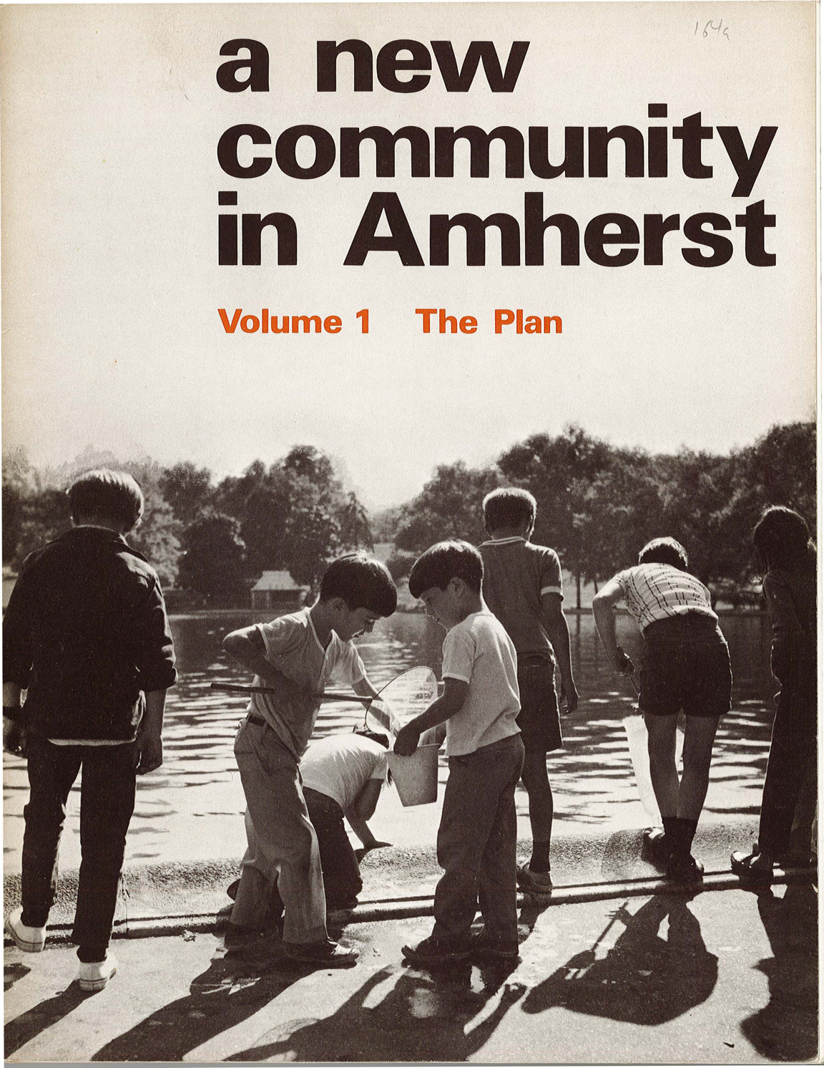
Metro Light Rail expansion from UB Main Street north through Amherst to the I-990 is based on obsolete Residential Population & Commercial Development Projections made in late 60’s and early 70’s that did not occur.

Slide 2
The Audubon New Community in Amherst
The 1971 two-volume document projected both residential and commercial development requirements north of Amherst UB campus:
A total of 9,300 dwelling units will be constructed between 1972 and 1980 to house the families of UB direct and indirect employees and students in a wide range of income groups;
There will be six new neighborhood centers containing shops, community services, a hospital and four local elementary schools;
There will be industrial and office development in four separate industrial areas and a high-quality new community center.

Slide 3
Audubon New Community - 1/10 of the Plan
The Urban Development Corporation study (1971) projected a need for over 9,300 dwelling units:
The Audubon Community is now built out at approximately
450 dwelling units plus another 500 apartments, so about 1/10 of the projected number!
This led to an estimated eventual 30,000 residents for the Audubon Community assuming an average household size of three:
The actual built-out population is about 2,800 including senior and low-income apartment residents, again 1/10 projections!

Slide 4
Realizing 10% of Planned Residents/Units
The following map show the areas (in red) within the corridor north of UB Amherst campus originally slated for residential development.
The subsequent map shows the actual area where residential development occurred.
The remaining space was largely deemed preserved wetlands or re-zoned for commercial use, which is also currently experiencing a high vacancy rate.

Slide 6
The planned residential development area consumed the entire prior page. Below is the entire area eventually developed for UB residential use as the Audubon New Community!

Slide 7
What was planned did not happen.
There is only one tenth the number of envisioned residential units in the area north of UB Amherst campus.
There is also about one tenth the population that was expected to require an expanded light rail transit system.
The student housing complexes along Sweet Home Road and north of Dodge Road, each comes with dedicated shuttle bus service, so no need for light rail.
Most of the land originally planned for development is dedicated wetlands now occupied by trees and wildlife. Neither of which need a light rail system.
The lack of actual residential development and population growth has rendered the original plan for a light rail extension obsolete. It lives on as nothing more than an NFTA pipe dream for an expanded bureaucracy.

